Slide 1
Mathematical Foundations for Data Science
MFDS Team

Slide 2
DSECL ZC416, MFDS
Lecture No. 2

Slide 3
Agenda
LU Decomposition (continued)
Motivation for numerical methods
Matrix Norms
Iterative Solution
  Gauss Seidel Method
  Gauss Jacobi Method
Convergence Criteria

Slide 4
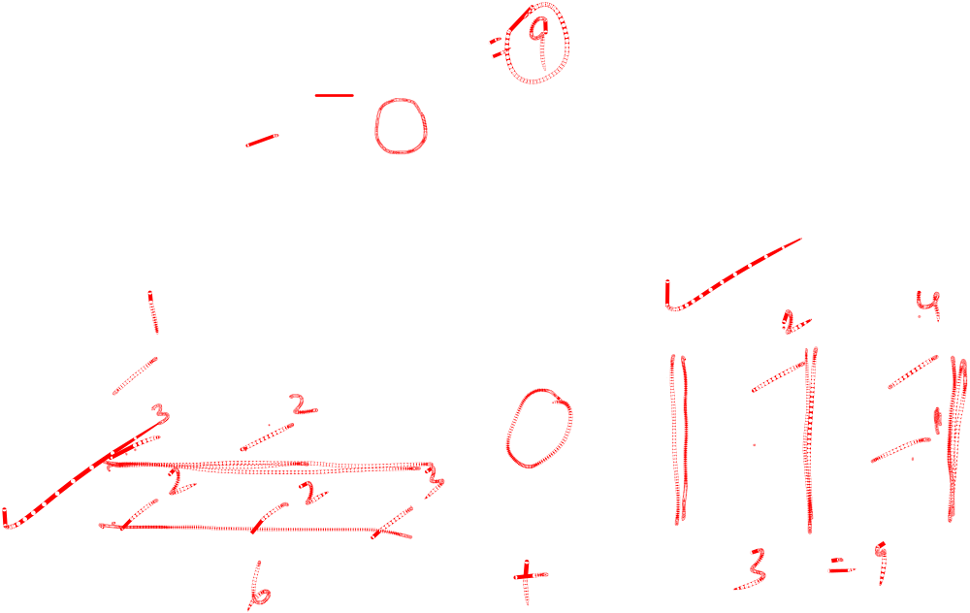
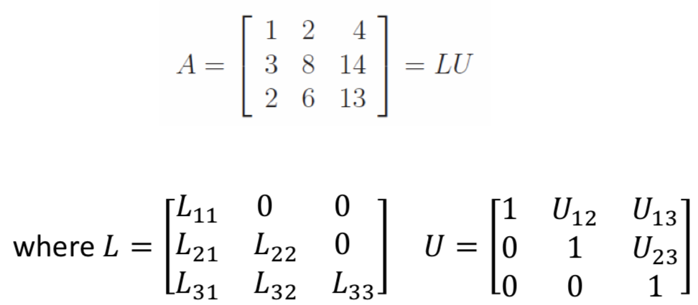

Crout’s Method

Slide 5
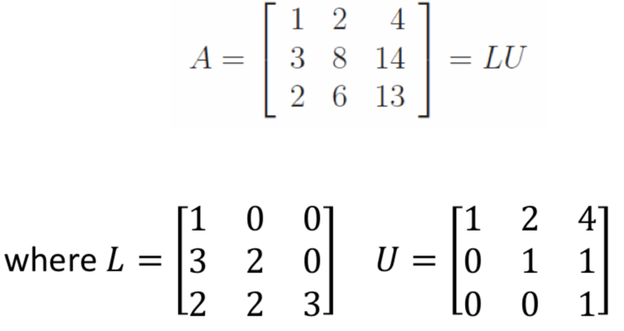
Crout’s Method

Slide 6
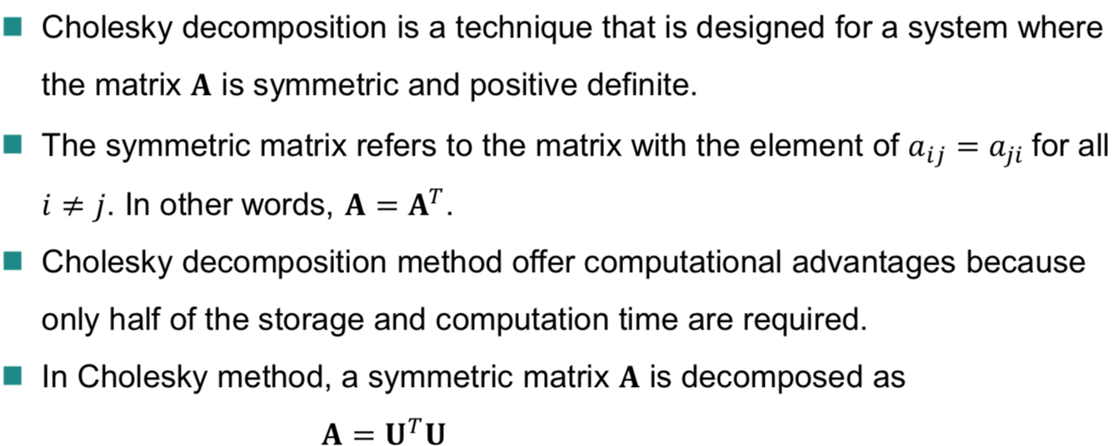
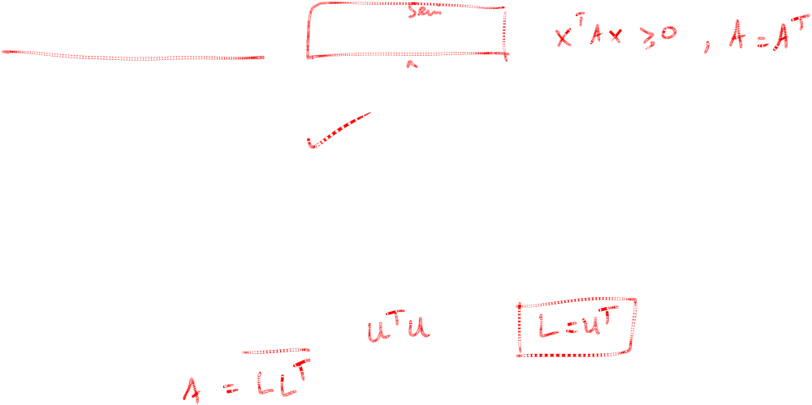
Cholesky Method

Slide 7
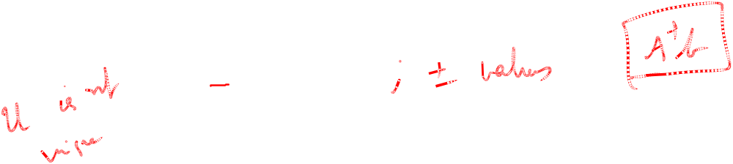
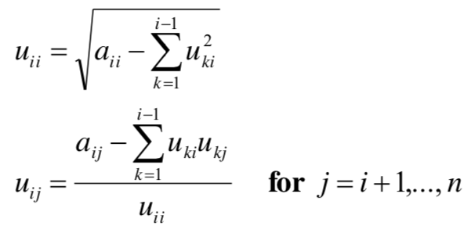
Cholesky Method
Decompose A such that A = U^{T}U. Hence, we may have U^{T}Ux = b
Set up and solve U^{T}d = b, where d can be obtained by using forward substitution
Set up and solve Ux = d, where x can be obtained by using backward substitution

Slide 8
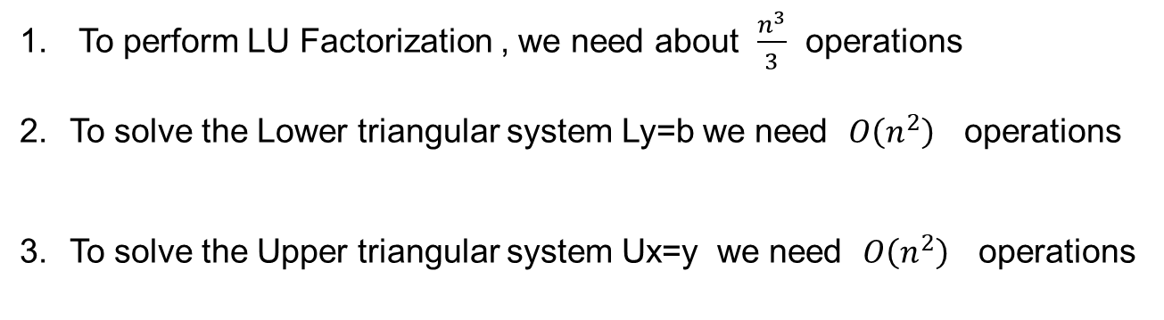
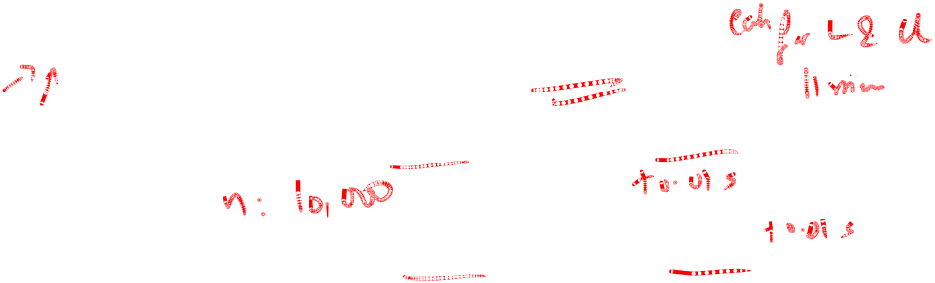
Computational Complexity
The LU decomposition is computed directly without solving simultaneous
equations
It is more economical to produce the LU Factorization
This is followed by solving two simpler linear systems

Slide 9

Motivation
Problem: Solve 7x = x + 18. (Solution x = 3)
Iterative Procedure: x_{i+1} = f(x_{i}), with x₁ given
Extension to Linear Systems?
Criteria for convergence (Similar to )
7x_{i +1} = x_{i} + 18 , x₁ = 1 x₂ = 2.7143 x₃ = 2.9592 x₄ = 2.9942 x₅ = 2.9992 x₆ = 2.9999 Converges to x = 3 | x_{i+1} = 7x_{i} – 18 , x₁ = 1 x₂ = -11 x₃ = -95 x₄ = -683 x₅ = -4799 x₆ = -33611 Diverges

Slide 10
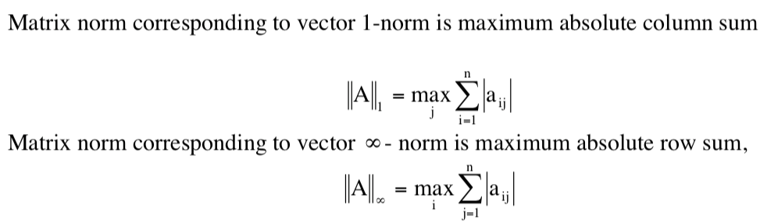
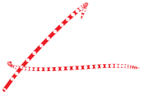



Matrix Norms
Some of the commonly used matrix norms are given below

Slide 11




Iterative Methods for Systems
Consider the normalized system Ax = b
Write A = I + L + U, where
  I is an identity matrix
  L is lower triangular matrix with diagonal entries 0
  U is upper triangular matrix with diagonal entries 0
Ax = (I + L + U)x = b
  x^{k+1} = -Lx^{k} – Ux^{k} + b (Gauss Jacobi)
  x^{k+1} = -(I + L)⁻¹Ux^{k} +(I + L)⁻¹b (Gauss Seidel)
Converges if < 1

Slide 12
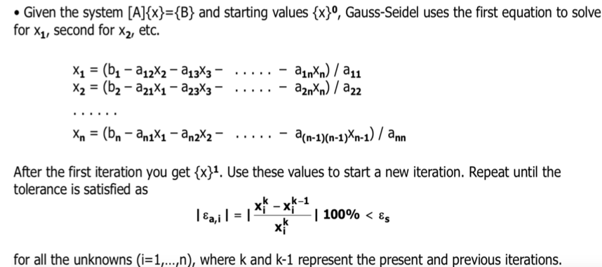
Gauss Seidel Method

Slide 13
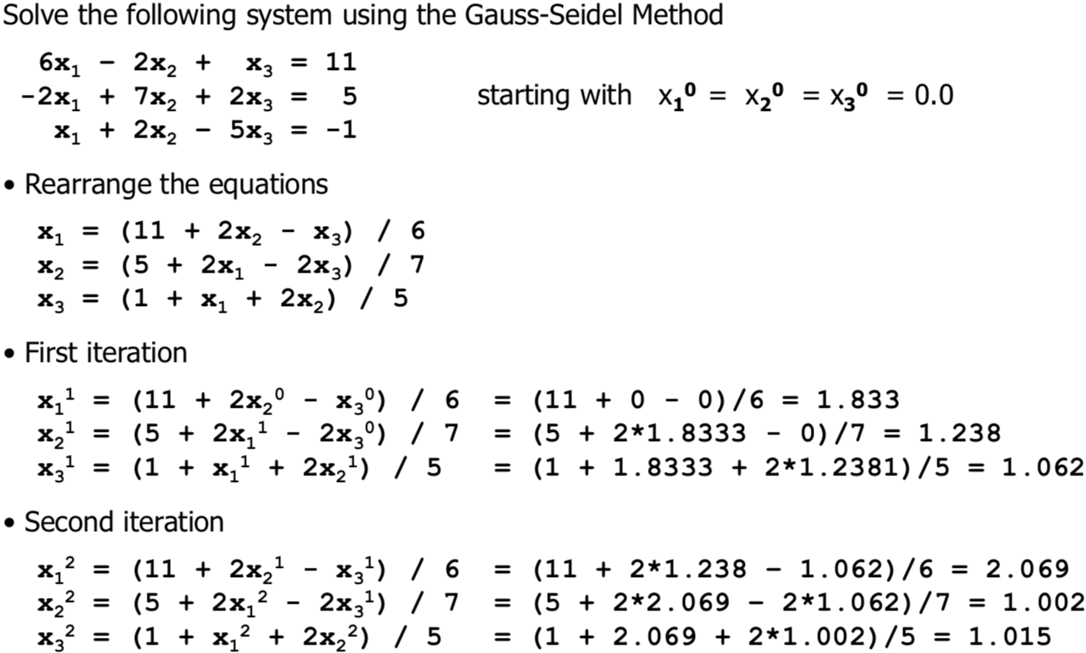
Gauss Seidel Method

Slide 14
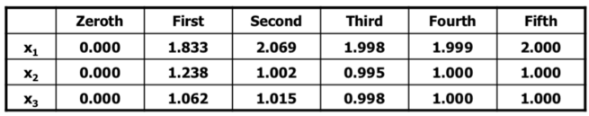
Gauss Seidel Method
Note: Always check the convergence using specified tolerance

Slide 15
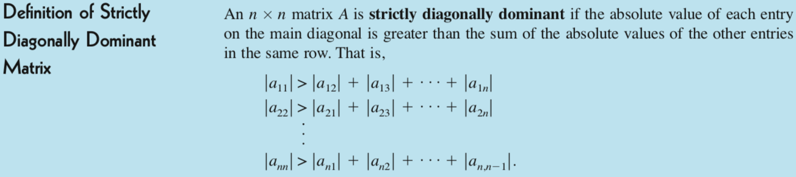
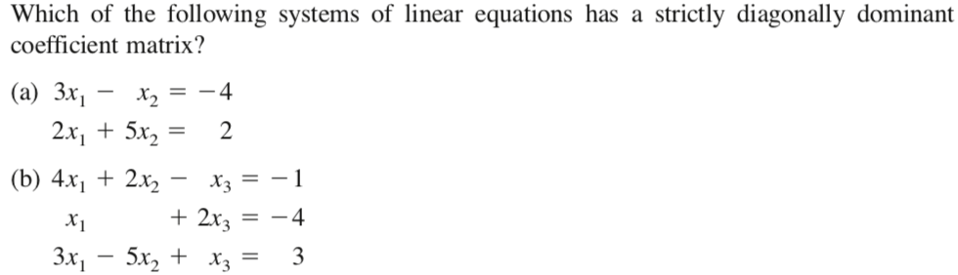

Diagonally Dominant Matrix
Theorem
?
?

Slide 16
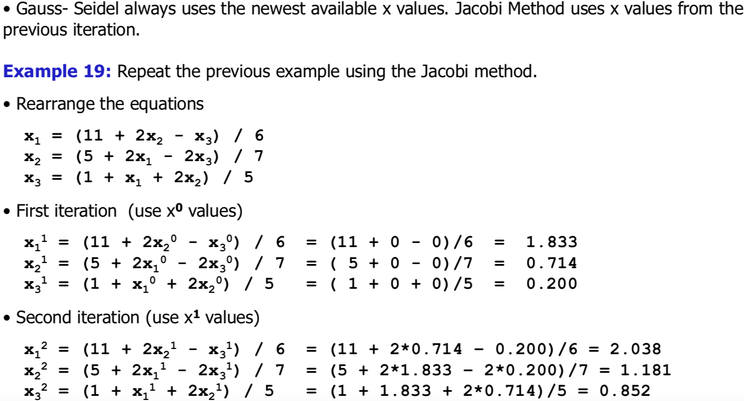
Gauss Jacobi Method

Slide 17
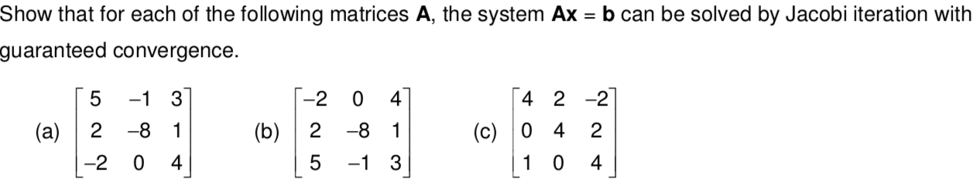
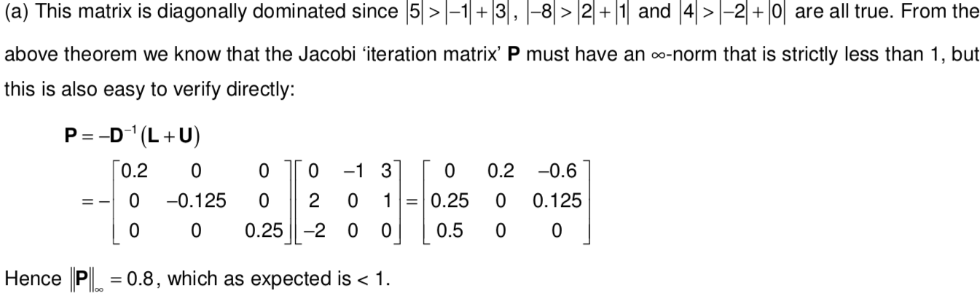
Convergence of Jacobi Method

Slide 18
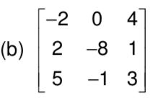
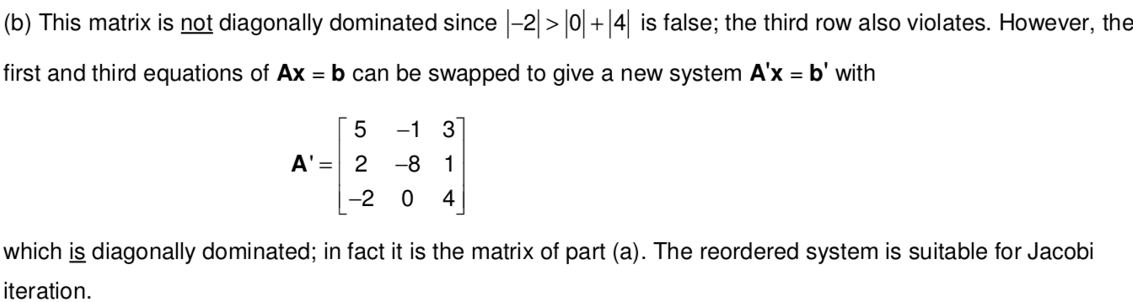
Convergence of Jacobi Method

Slide 19
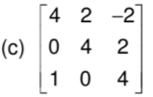
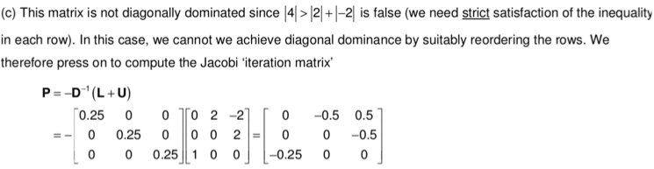

Convergence of Jacobi Method
Diagonal dominance is not necessary but sufficient condition
Column sum

Slide 20
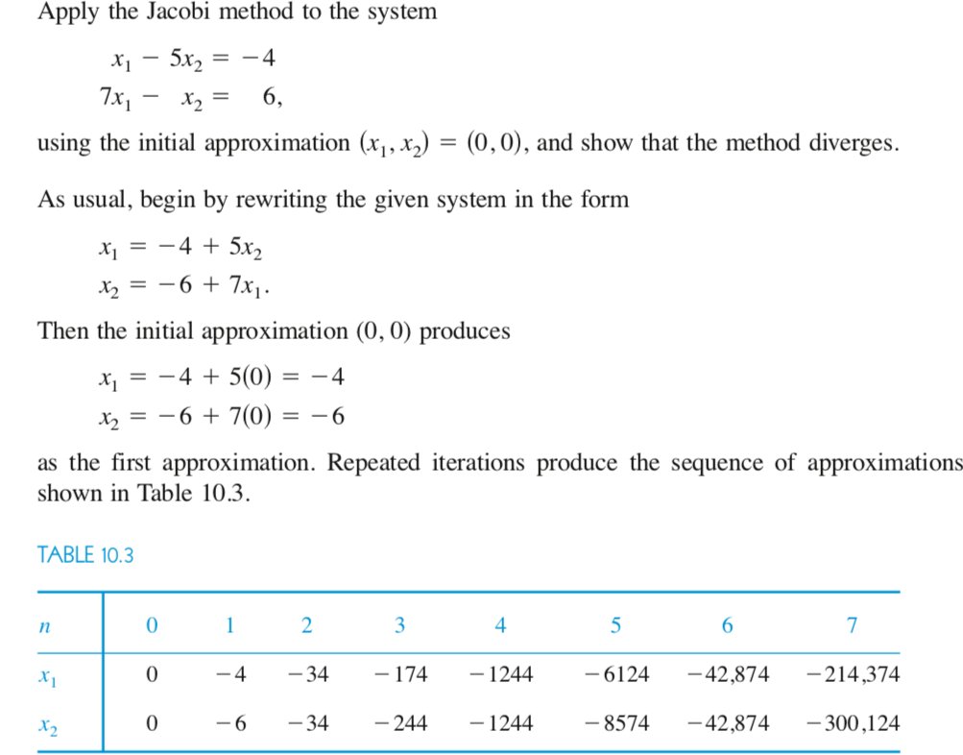
Example of Divergence
Ex 1

Slide 21
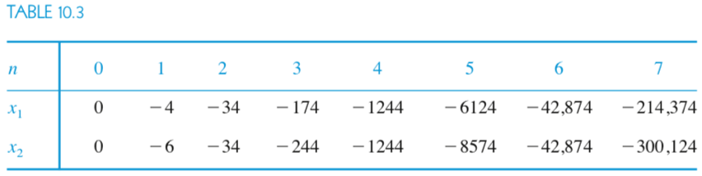
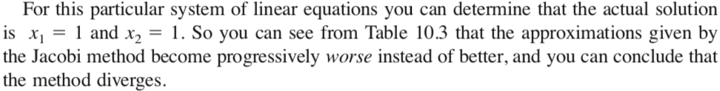
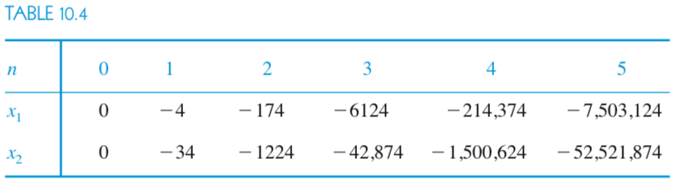
Example of Divergence
JACOBI METHOD
GAUSS SEIDEL METHOD

Slide 22
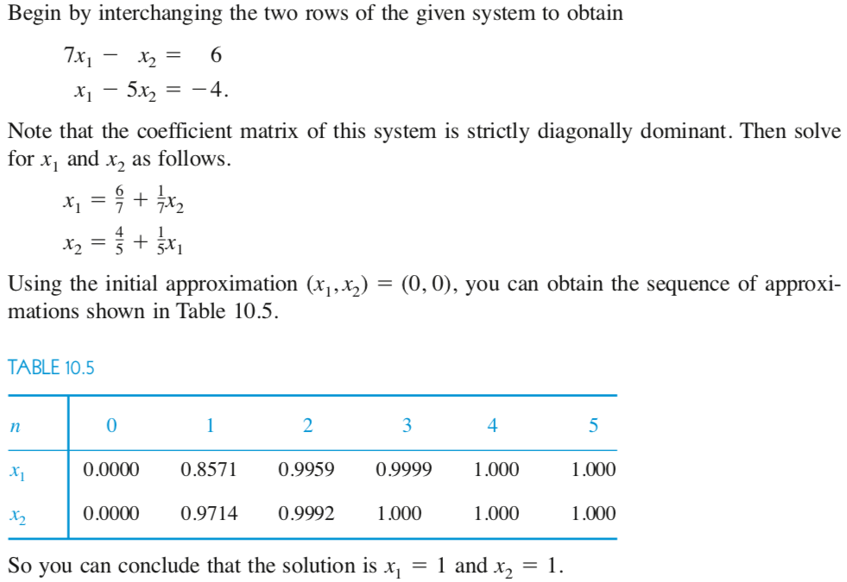
Diagonally Dominant Matrix
Ex 1

Slide 23

Diagonally Dominant Matrix
Do not conclude that strict diagonal dominance is a necessary condition for convergence of the Gauss Jacobi or Gauss- Seidel methods. For instance, the coefficient matrix of the system
is not a strictly diagonally dominant matrix, and yet both methods converge to the solution x₁ = 1 and x₂ = 1 when you use an initial approximation of
(x₁, x₂) = (0,0).

